Slide 1
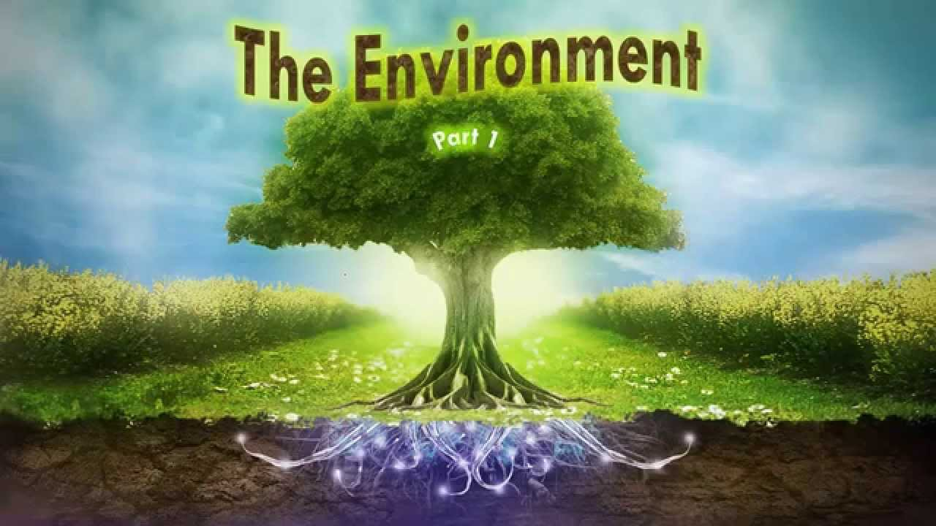
THE WORK DONE BY THE STUDENTS OF THE 10BFORM, SCHOOL 130, ODESSA, UKRAINE

Slide 2
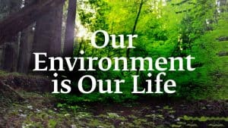
Environment – is a natural habitat that surrounds us everywhere.

Slide 3

The relationship between humanity and the environment is a delicate balance.

Slide 4

The environment is something you are very familiar with. It's everything that makes up our surroundings and affects our ability to live on the earth—the air we breathe, the water that covers most of the earth's surface, the plants and animals around us, and much more.

Slide 5

'environment' simply means 'surroundings' (environs); hence the environment of an individual, object, element or system includes all of the other entities with which it is surrounded. However, in reality, individuals, objects, elements and systems rarely exist in isolation; instead, they tend to interact to varying extents with their surrounding entities. Therefore, it is not particularly helpful to conceptualise the 'environment' without including in that conceptualisation some notion of relationship. Individuals, objects, elements and systems influence - and are in turn influenced by - their surroundings. Indeed, the networks of relationships that exist between different entities may, in some cases, be extensive and highly complex. Thus the 'environment' may be regarded as a 'space' or a 'field' in which networks of relationships, interconnections and interactions between entities occur. To those who have studied the science of ecology, such a conceptualisation will be familiar, since ecologists are concerned with both the biotic (living) and abiotic (non-living) components of environmental systems - and especially with the interactions of those components. In fact, the term 'environment' is often used interchangeably with an ecological term 'ecosystem', which may be defined as a community of interacting organisms together with their physical surroundings. The notion of interrelationship is a central one in environmental science and management, since many environmental issues have occurred because one environmental system has been disturbed or degraded - either accidentally or deliberately - as a result of changes in another.

Slide 6
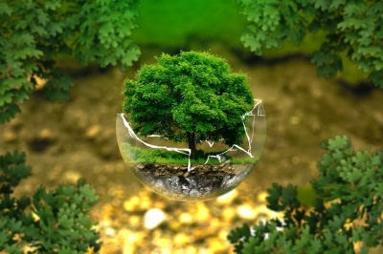
Environment is everything that is around us. It can be living or non-living things. It includes physical, chemical and other natural forces. Living things live in their environment. They constantly interact with it and adapt themselves to conditions in their environment. In the environment there are different interactions between animals, plants, Insects, soil, water, and other living and non-living things.

Slide 7

Since everything is part of the environment of something else, the word environment is used to talk about many things. People in different fields of knowledge use the word environment differently. Electromagnetic environment is radio waves and other electromagnetic radiation and magnetic fields. The galactic environment refers to conditions between the stars.

Slide 8
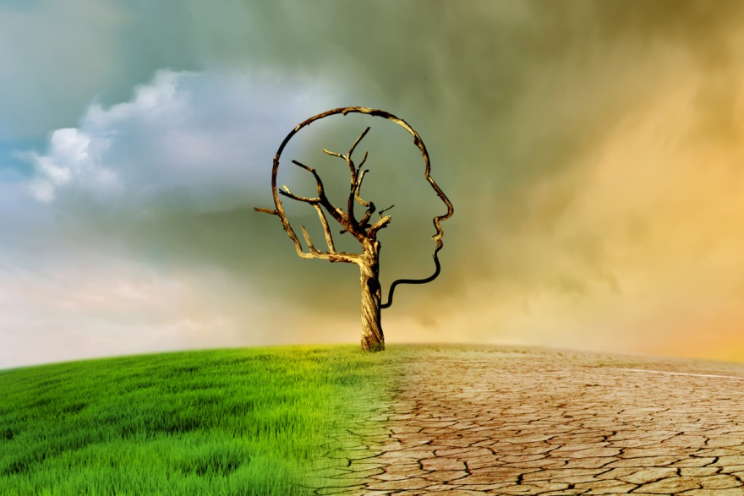
In psychology and medicine, a person's environment is the people, physical things and places that the person lives with. The environment affects the growth and development of the person. It affects the person's behaviour, body, mind and heart.

Slide 9
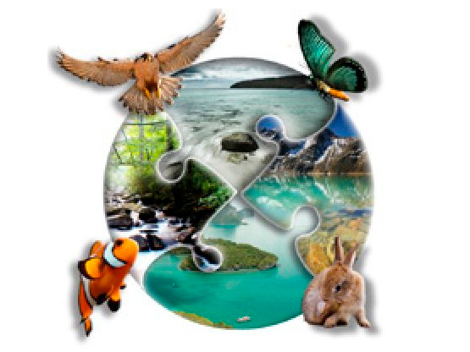
A person's environment is the events and culture that the person lived in. Environment is everythings around us. A person's beliefs and actions depend on his environment.

Slide 10
